Slide 1

Parents and Carers · Primary · Session 5
Partnership with the School
Notes:
SUGGESTED TIME: 1 min · 1:30 - 1:31
PURPOSE
Open the partnership session and connect it to what families have noticed at home.
WHAT TO DO
1. Name the shift from what happens at home to how home and school can understand and act together.
2. Ask participants to keep in mind one thing they noticed at home in Session 4 that school might need to know.
3. Keep the child at the centre of the conversation.
4. Acknowledge that participants will bring very different school experiences, some helpful and some difficult.
5. Remind the room that sharing is voluntary, and that schools and staff are not named in the whole group.
KEY MESSAGES
• Partnership is part of understanding and supporting your child, from the start.
• Your child, your family and the school may each hold different parts of the picture.
KEEP IN MIND
• Some families are in a very hard place with their school right now. Acknowledge this without inviting detailed accounts in the whole group.
THREAD
Picks up what participants noticed at home in Session 4 (Home and Community).

Slide 2
Working in partnership
Family
School staff
What is the goal of these intersecting partnerships?
Every partner brings different knowledge and a different relationship with your child.
Your child is at the centre of every partnership.
Your child
Support staff
Notes:
SUGGESTED TIME: 3 min · 1:31 - 1:34
PURPOSE
Show where the partnerships around a child intersect, with the child at the centre of every one.
WHAT TO DO
1. Introduce the diagram: family, school staff and support staff, with your child at the centre where they overlap.
2. Explain that every partner brings different knowledge and a different relationship with your child and with each other.
3. Ask the group: What is the goal of these intersecting partnerships?
4. Steer the discussion so the point is made that the child is at the centre of every partnership.
5. Ask who else might be part of the picture for their child, such as a therapist, grandparent or out-of-school-hours carer, and how the child's own communication can be included.
YOU MIGHT SAY
What is the goal of these intersecting partnerships?
KEY MESSAGES
• Positive partnership keeps your child at the centre.
• No single person holds the complete picture.
• Parents and carers bring knowledge of their child that no one else has.
KEEP IN MIND
• Use the diagram as a discussion prompt rather than a complete definition.
THREAD
Draws on 'You are the expert on your child' from Session 1.

Slide 3

Building a home-school partnership
Parents and families are the first and continuing educators of their children
Learning is lifelong and occurs in multiple settings
Partnerships, schools and school communities flourish when the diversity and strengths of families are valued and leveraged
Community engagement expands responsibility and resources
Partnerships grow from mutual trust, respect and responsibility
Partnerships need committed, collaborative and creative leadership
Family-School Partnerships Framework, Department of Education, 2020
Notes:
SUGGESTED TIME: 2 min · 1:34 - 1:36
PURPOSE
Use the Family-School Partnerships Framework principles to show what families can expect a partnership to look like.
WHAT TO DO
1. Walk through the six Framework principles briefly.
2. Draw attention to the first principle: parents and families are the first and continuing educators of their children.
3. Position family knowledge and school knowledge as different, useful perspectives.
4. Name what partnership looks like in practice: a shared purpose, respectful listening, your child's voice, clear information, and agreed next steps with follow-up.
KEY MESSAGES
• Your knowledge of your child and the school's knowledge are both needed from the beginning.
• Listening, clarity and shared next steps are things you can look for in practice.
KEEP IN MIND
• Avoid implying that agreement is needed before listening or respect are possible.
RESOURCES
Family-School Partnerships Framework - Department of Education, Australian Government - https://www.education.gov.au/supporting-family-school-community-partnerships-learning/family-school-partnerships/family-school-partnerships-framework

Slide 4
What is effective collaboration?
Shared goals
Seeing other perspectives
Shared values
Invite curiosity: How could we work together so school goes well for my child?
Mutual trust and respect
Centring your child’s voice
Consult on decision-making
Assume good intent
Notes:
SUGGESTED TIME: 3 min · 1:36 - 1:39
PURPOSE
Name the collaboration principles that strong partnerships share, whoever is at the table.
WHAT TO DO
1. Introduce why collaboration matters: for an Autistic child there are many people and many points where home and school need to work together.
2. Explain that the key collaboration principles are the same across every partnership around your child.
3. Ask the group: What are some of the key principles for effective collaboration?
4. Build the discussion to cover: shared goals, shared values, mutual trust and respect, consulting on decision-making, seeing other perspectives, inviting curiosity, centring your child's voice and assuming good intent.
5. Click to reveal the points on the slide once the room has contributed.
YOU MIGHT SAY
What are some of the key principles for effective collaboration?
How could we work together so school goes well for my child?
KEY MESSAGES
• The same principles apply in every partnership around your child.
• Assuming good intent and staying curious can help, even when a conversation is hard.
KEEP IN MIND
• 'Assume good intent' can be hard to hear for families who have had poor experiences. Acknowledge that trust is built on both sides and is not the family's job alone.

Slide 5

Power dynamics
Power can sit in:
Your child
Socio-economic status
Historical / cultural experiences of education
Speaking English vs speaking a language other than English
How school works: teaching approaches, school systems and curriculum
Home
School
Perception of the importance / experience of school
Notes:
SUGGESTED TIME: 3 min · 1:39 - 1:42
PURPOSE
Help participants notice how agendas, language, authority and decision-making can shape a school conversation.
WHAT TO DO
1. Introduce the seesaw: school, home and your child.
2. Name where power can sit: socio-economic status, historical and cultural experiences of education, speaking English or another language, how school works (teaching approaches, school systems and curriculum), and how important school is seen to be.
3. Ask the power questions below to look at how meetings work, not to blame anyone.
4. Invite participants to think about where school language, timing or process has made it harder for them to take part.
YOU MIGHT SAY
Who sets the agenda?
Whose knowledge is heard?
Who can make decisions?
Is your child included in a way that works for them?
What could change about the process?
KEY MESSAGES
• Power sits in meeting structures, language and decision pathways, as well as in people.
• Naming an imbalance can help you plan for a more balanced conversation.
KEEP IN MIND
• Keep sharing voluntary and avoid detailed complaints about identifiable schools or staff in the whole group.

Slide 6
Power dynamics activity
On sticky notes:
1
Write an example of an imbalance in power dynamics from a home perspective.
2
Write an example of an imbalance in power dynamics from a school perspective.
3
Write how you could address these imbalances.
Share at your table, or add your notes to the wall under Home, School and Solutions.
Notes:
SUGGESTED TIME: 6 min · 1:42 - 1:48 · Workbook - Power dynamics
PURPOSE
Help participants reflect on real and perceived power imbalances in the home-school relationship, and look for ways to address them.
WHAT TO DO
1. Make sure every participant has sticky notes and a pen.
2. Direct participants to the three instructions on the slide.
3. Choose a sharing option that suits the room (see steps).
4. Support tables to look for solutions rather than place blame.
5. Take feedback from a few participants at the end.
KEY MESSAGES
• Power can be structural, historical, cultural, conscious and unconscious.
• Status can be felt as an imbalance of power, regardless of anyone's intent.
ACTIVITY: Sticky note reflection · table groups · 6 minutes
Prompt: Where do power imbalances sit in the home-school relationship, and how could they be addressed?
1. On one sticky note, write an example of an imbalance in power dynamics from a home perspective.
2. On a second, write an example from a school perspective.
3. On a third, write how you could address these imbalances.
4. Option 1: share your notes with your table.
5. Option 2: add your notes to the butcher's paper on the wall under Home, School and Solutions.
Bring the room back:
• Who sets the agenda?
• Whose knowledge is heard?
• Who can make decisions?
• What could change about the process?
Close: Ask participants to keep one idea from the Solutions column for their conversation plan on slide 13.
KEEP IN MIND
• This may be painful for some participants who have felt powerless in dealings with school. Acknowledge this, and guide the group towards solutions rather than blame.
• Asking for a school perspective is not asking families to excuse poor practice. It helps them plan a conversation that is more likely to work.
BACKGROUND
Educators work inside the culture of education, including shared acronyms such as NAPLAN, NCCD and IEP, which families may not know. Some people naturally give teachers higher status, which can be a cultural or personal attitude. External providers and professionals can also affect the power dynamic around an Autistic child.
THREAD
The solution chosen here carries into the conversation plan on slide 13 and the Session 6 take-home actions.

Slide 7

Student voice
What decisions were made, and who made them?
What impact did those decisions have on Adon?
Notes:
SUGGESTED TIME: 4 min · 1:48 - 1:52 · Workbook - Student voice
PURPOSE
Show what can happen when a child is not listened to or consulted, and why your child's voice belongs in decisions about them.
WHAT TO DO
1. Introduce the video as an example of a student who is not listened to or consulted.
2. Ask participants, while watching, to pay attention to what decisions were made and who made them.
3. Play the video.
4. Ask the group: What impact did those decisions have on Adon?
5. Connect to participants' own children: how are their preferences asked for and heard, at home and at school?
YOU MIGHT SAY
While watching, pay attention to what decisions were made and who made them.
What impact did those decisions have on Adon?
KEY MESSAGES
• Children should have a say in decisions about them, at their level and in the way they communicate.
• Even young children can show preferences: choices offered visually, reactions observed and honoured.
• Ask your child in a way that works for them: What helps? What's hard? What should your teacher know?
• Their answers can go to school in their own words, drawings or choices.
• This is an early step in building self-advocacy.
KEEP IN MIND
• Some parents may recognise their own child's experience in the video. Allow a moment before moving on.
THREAD
Links to multimodal communication and AAC in Session 3: voice can be spoken, written, drawn, typed or shown.

Slide 8

What works?
Think of a time you worked well with someone at school.
What made it work? What did they do, and what did you do?
What works for everyone at the table:
Be prepared for meetings
Share information
Ask questions
Seek clarification
Start from what you both want for your child
Notes:
SUGGESTED TIME: 6 min · 1:52 - 1:58 · Workbook - What works?
PURPOSE
Draw on school relationships that have already worked, and name the moves that work for everyone at the table.
WHAT TO DO
1. Ask participants to think of a time they worked well with someone at school, such as a teacher, a learning support staff member or a principal.
2. Discuss the prompts on the slide in table groups.
3. Ask groups to feed back a few key ideas to the whole room.
4. Point to the list of what works for everyone at the table and add practical examples of each.
YOU MIGHT SAY
What made it work? What did they do, and what did you do?
KEY MESSAGES
• Ask for the agenda before the meeting, so you know what to expect.
• You can bring a support person. This is normal and allowed, and it can change the feel of the meeting.
• Bring notes, and ask for notes or minutes to be shared.
• Follow up in writing ('As we agreed...'), so everyone is clear on what was agreed.
• If a meeting went badly, it is fine to ask for a fresh start next time.
ACTIVITY: Table reflection · small groups · 6 minutes
Prompt: Think of a time you worked well with someone at school. What made it work? What did they do, and what did you do?
1. Think of a time you worked well with someone at school.
2. Discuss the prompts at your table.
3. Keep examples general and do not name staff or schools.
Bring the room back:
• What key ideas came up at your table?
Close: Connect the ideas shared to the list on the slide: be prepared for meetings, share information, ask questions, seek clarification, start from what you both want for your child.
KEEP IN MIND
• Some participants may not have a positive example yet. Invite them to think of any relationship that worked, in or out of school, or to listen and take ideas from others.
• Some families have a hard history with their school, and trust may need rebuilding before anyone can assume the best. Acknowledge this, and keep the focus on what both sides want for the child.
BACKGROUND
Parent and family engagement in learning happens when schools support families to take part in their child's learning in equal partnership with the school. Parents are the experts on their child and an extremely valuable resource (Barker & Harris, 2020).
RESOURCES
Barker, B., & Harris, D. (2020). Parent and Family Engagement: An Implementation Guide for School Communities. Canberra: ARACY

Slide 9
Consultation literacy
Useful consultation includes:
A clear, shared purpose
Open questions
More than one way to contribute
Respect for your knowledge and your child’s
Accurate recording of what was heard
An agreed action, responsibility and follow-up
Ask, listen, and follow up.
Notes:
SUGGESTED TIME: 3 min · 1:58 - 2:01 · Workbook - Consultation checklist
PURPOSE
Show families what useful consultation includes, so they can recognise it and ask for it.
WHAT TO DO
1. Walk through what useful consultation includes.
2. Frame the list as a check families can use before and after a school meeting.
3. Make the point: ask, listen, and follow up.
4. Link back to Your rights at school from Session 1: the school must consult your child, or you on their behalf. This list helps make that consultation useful.
KEY MESSAGES
• Ask, listen, and follow up.
• Useful consultation includes an agreed action, who is responsible and when it will be followed up.
THREAD
Links back to Your rights at school in Session 1: under the Disability Standards for Education, consultation is a requirement.
RESOURCES
Australian Education Research Organisation (2024). Engaging with families of children with disability: Schools practice guide - https://www.edresearch.edu.au/guides-resources/practice-guides/engaging-families-children-disability-schools-guide

Slide 10
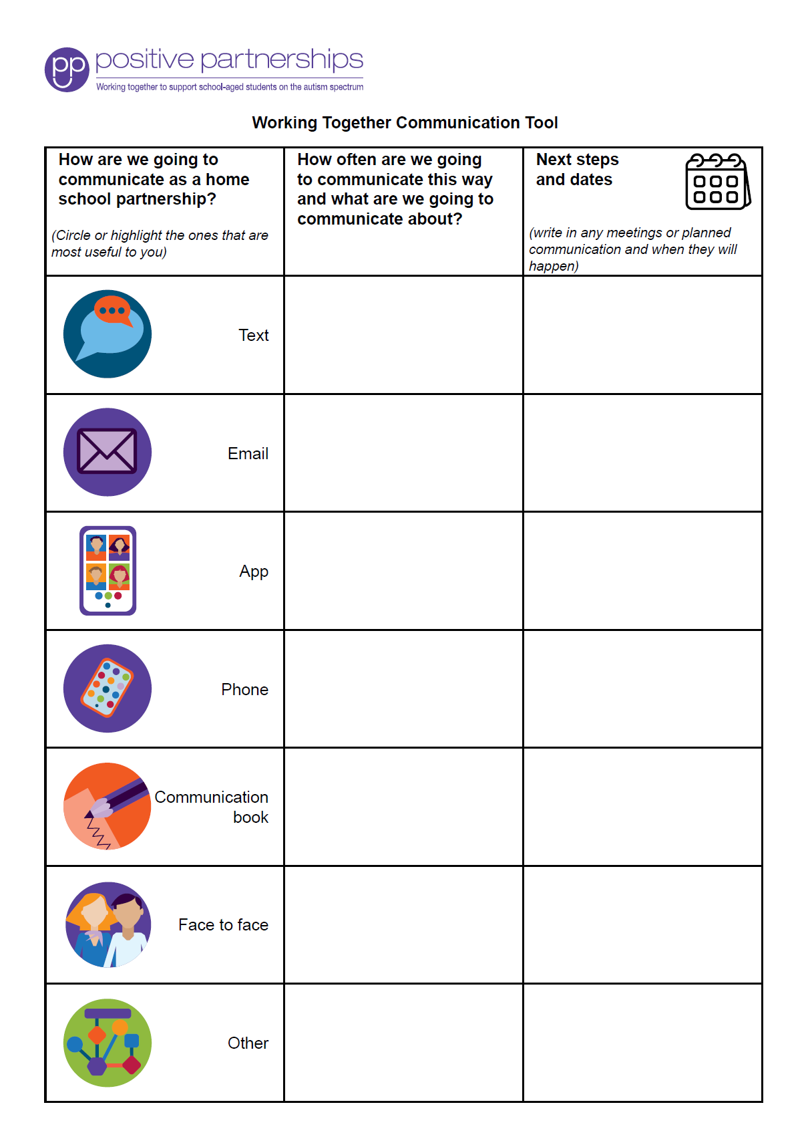
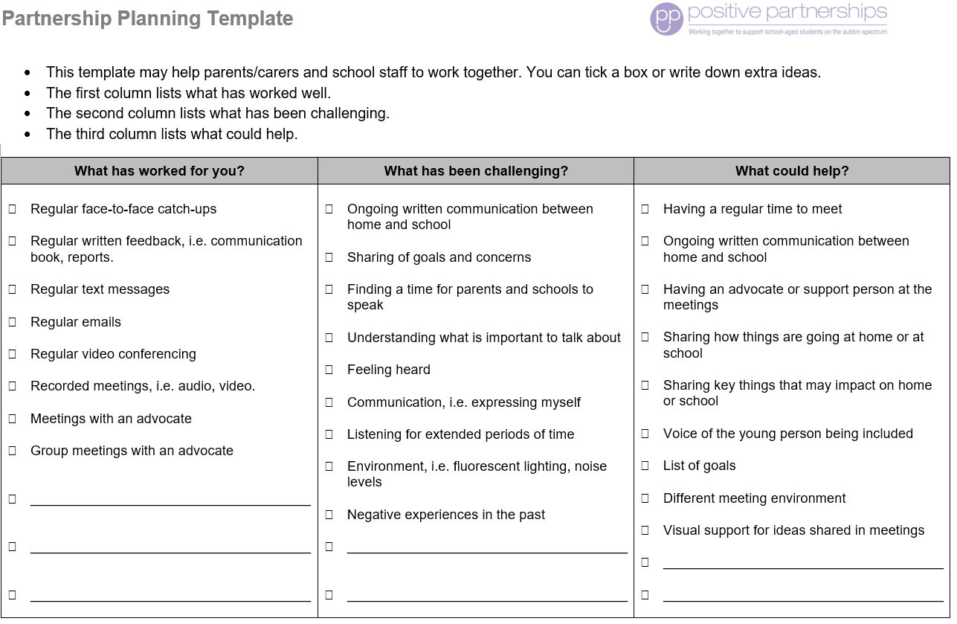
Partnership tools
Notes:
SUGGESTED TIME: 1 min · 2:01 - 2:02
PURPOSE
Show the Partnership tools and how families can use them to prepare for and follow up a school meeting.
WHAT TO DO
1. Show the Partnership tools and briefly explain how each one is used.
2. Frame the tools as supports for consultation, not replacements for listening and your child's voice.
KEY MESSAGES
• Tools support a conversation. They do not replace listening and your child's voice.

Slide 11
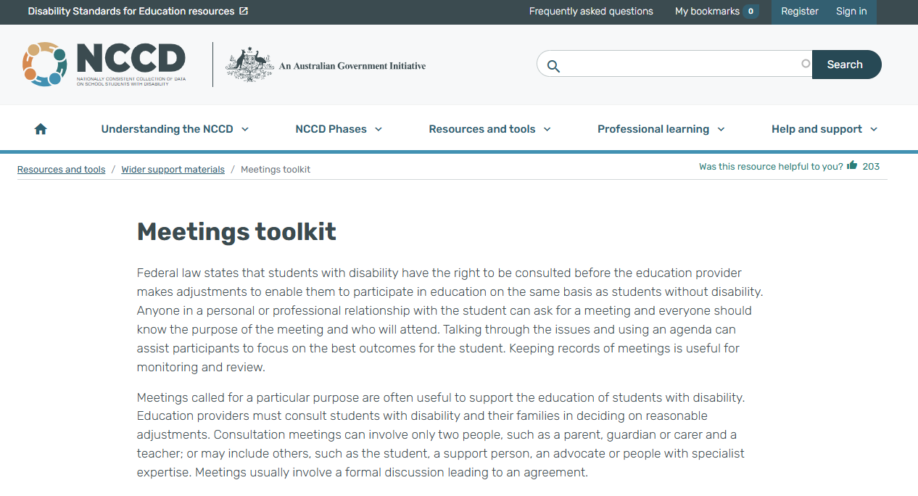
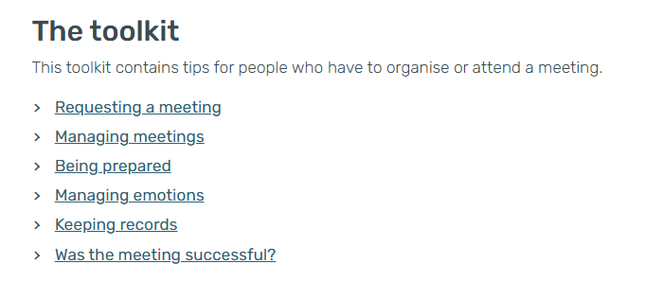
NCCD Meetings Tool Kit
A free tool kit to help families and schools prepare for meetings about adjustments: before, during and after the meeting.
Notes:
SUGGESTED TIME: 1 min · 2:02 - 2:03
PURPOSE
Introduce the NCCD Meetings Tool Kit as a free resource for families preparing for meetings about adjustments.
WHAT TO DO
1. Explain that the Tool Kit helps families and schools prepare for meetings about adjustments: before, during and after the meeting.
2. Point families to the Tool Kit on the NCCD website: https://www.nccd.edu.au/wider-support-materials/meetings-toolkit
KEY MESSAGES
• The Tool Kit is free and made for families as well as schools.
KEEP IN MIND
• Do not explain NCCD in detail. If asked, talk about levels of adjustment and point to the official NCCD information.
RESOURCES
NCCD Meetings Tool Kit - https://www.nccd.edu.au/wider-support-materials/meetings-toolkit

Slide 12
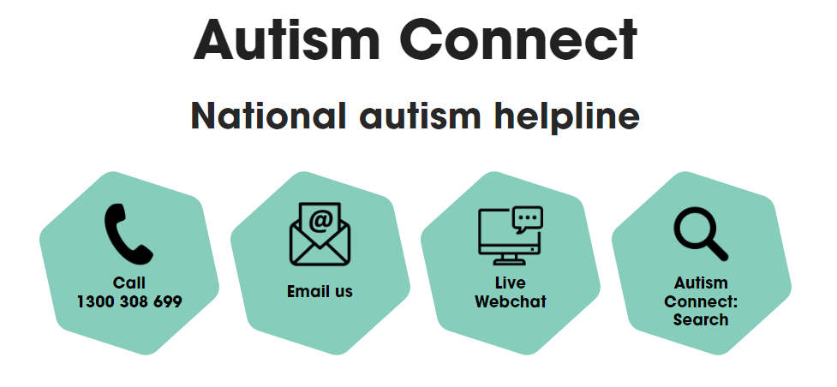


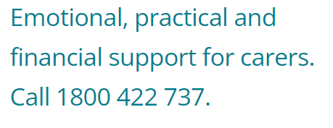

Other practical supports
Lifeline
13 11 14
Kids Helpline
1800 55 1800
Also supports parents and carers
Notes:
SUGGESTED TIME: 1 min · 2:03 - 2:04
PURPOSE
Point families to national helplines and support pathways.
WHAT TO DO
1. Briefly introduce Autism Connect (the national autism helpline), Disability Gateway and Carer Gateway.
2. Note that Carer Gateway offers emotional, practical and financial support for carers.
3. Point out Lifeline (13 11 14) and Kids Helpline (1800 55 1800). Kids Helpline also supports parents and carers.
4. Leave the slide up so participants can note or photograph the numbers.
KEY MESSAGES
• Help is available beyond today, for your child and for you.
KEEP IN MIND
• Check phone numbers and services are current before delivery.
RESOURCES
Disability Gateway - 1800 643 787
Carer Gateway - 1800 422 737
Autism Connect national autism helpline - contact details as shown on the slide
Lifeline - 13 11 14
Kids Helpline - 1800 55 1800 (also supports parents and carers)

Slide 13
Prepare for a conversation with school
Prepare for one purposeful conversation.
What needs to be understood?
What question will open the conversation?
How will your child’s voice be included?
What can be decided together?
How and when will we follow up?
Bring these notes to Session 6.
Notes:
SUGGESTED TIME: 6 min · 2:04 - 2:10 · Workbook - Prepare for a conversation with school
PURPOSE
Help each participant prepare for one purposeful conversation with school, to carry into the Session 6 take-home actions.
WHAT TO DO
1. Ask participants to think of a real or likely conversation with school.
2. Invite them to work through the prompts on the slide privately.
3. Encourage short notes rather than a full meeting plan.
4. Ask participants to carry one idea from the power activity into their plan.
5. Keep sharing optional, particularly where the situation is sensitive.
YOU MIGHT SAY
Keep these notes for your conversation plan in Session 6.
KEY MESSAGES
• Prepare for one purposeful conversation.
• A small, specific next step is enough.
ACTIVITY: Private planning · on your own · 6 minutes
Prompt: Prepare for one purposeful conversation.
1. What needs to be understood?
2. What question will open the conversation?
3. How will your child's voice be included?
4. What can be decided together?
5. How and when will we follow up?
Close: Ask participants to circle the question they will open with and keep these notes for Session 6.
THREAD
Feeds the second of the three small things in Session 6: one thing you would like school to know, understand or support, and the sentence you will open with.

